Slide 1
Estimating uncertainty
Cole Monnahan, André Punt, Grant Adams

Slide 2
Recap
We postulate a model
Implement model by calculating NLL for parameters and data
Use optimizer to find MLE
But this tells us nothing about how much confidence we should have in our MLEs
We need to estimate uncertainty!

Slide 3
Estimating uncertainty
Uncertainty estimates can be calculated in several ways
Asymptotic approximation + delta method
Likelihood profiles
Simulation
Non-parametric bootstrapping
Bayesian credible intervals (not covered)

Slide 4
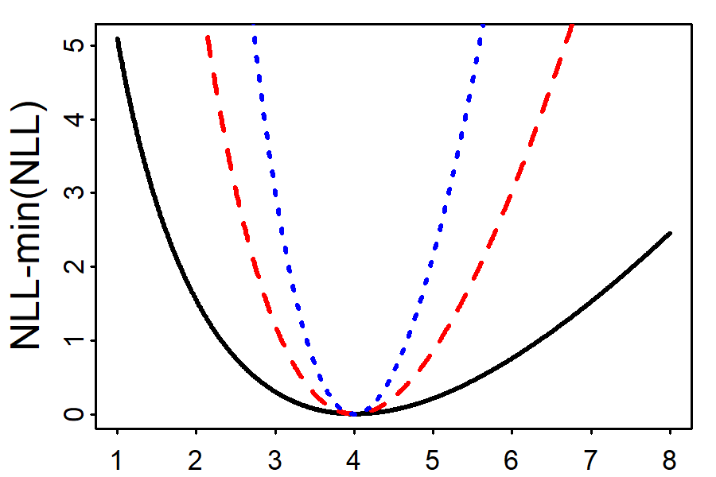

Asymptotic approximations
Let’s use a contrived Poisson example
3 curves have same MLE but different data
As data increases:
NLL gets narrower
Shape becomes more like a symmetric parabola
Remember that as
$n→∞$ MLE becomes normal

Slide 5
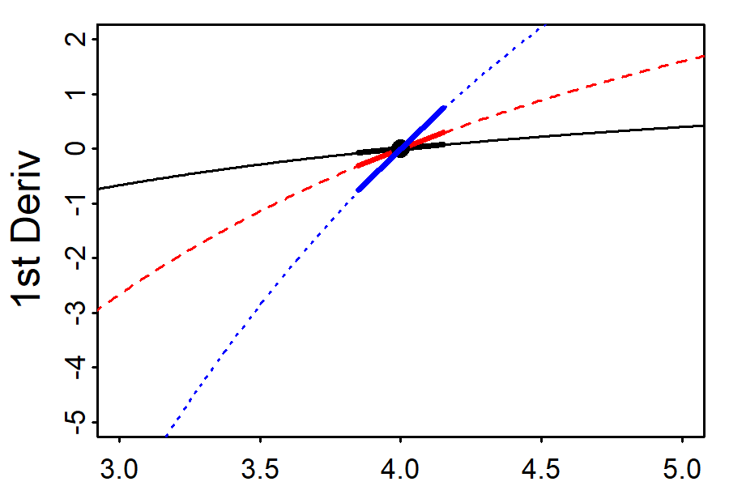

Asymptotic approximations
Remember: 2nd derivative = derivative of derivative
$$\frac{d}{dx}\left(\frac{dy}{dx}\right)$$
The derivatives are 0 at the MLE (by definition)
The slopes at the MLE are different
They are all positive (because it is a minimum)
Which is most uncertain?

Slide 6
Asymptotic approximations
2nd deriv = how “steep” the curve is at the MLE
For a 1d model, standard error = SE = 1/(2nd deriv)
(2nd derivative) | SE
1.75 | 0.76
2.00 | 0.71
5.00 | 0.45

Slide 7
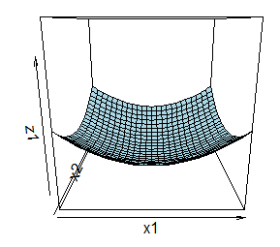
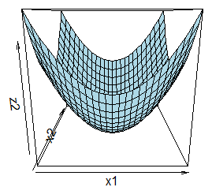
Multivariate asymptotics
For N-d model, the shape is represented by a NxN “Hessian” matrix of 2nd derivatives
Inverting the Hessian gives us a covariance matrix
Same intuition about “steepness”
Which will have smaller SEs?

Slide 8
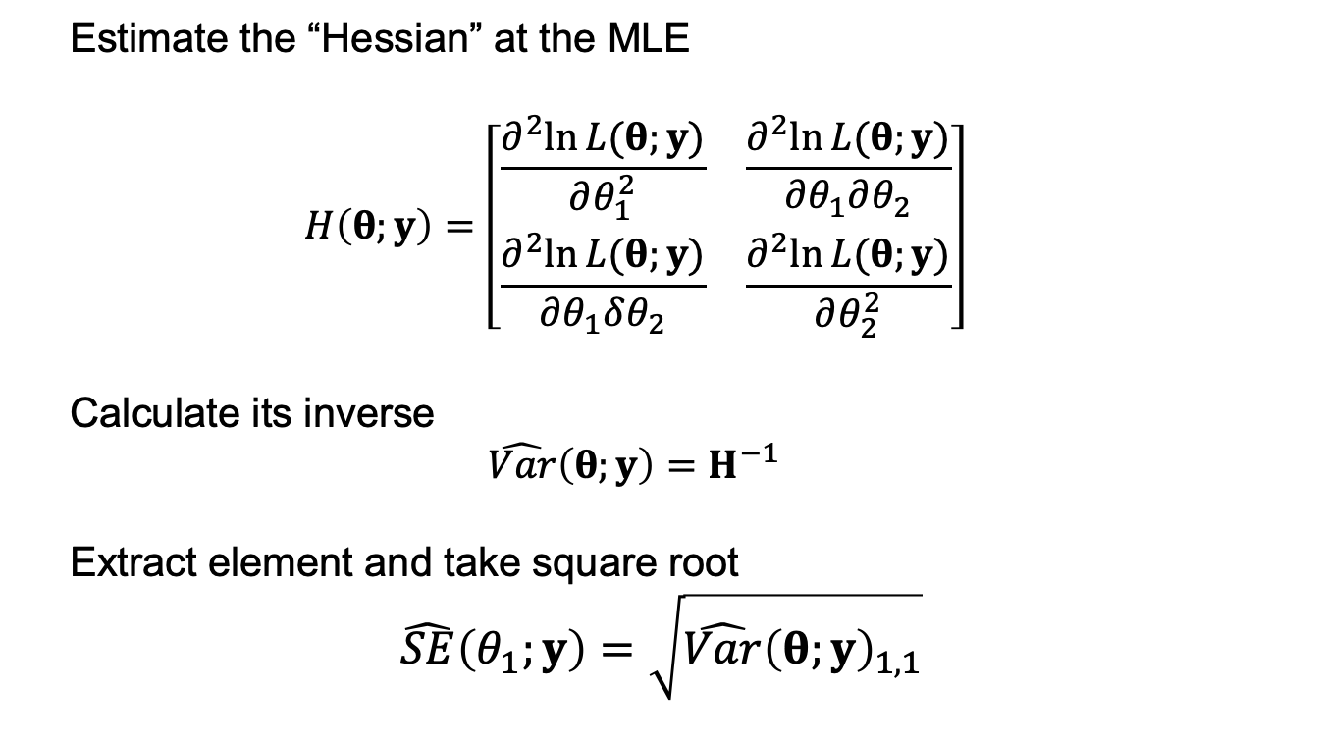
How to estimate standard errors?
Estimate the “Hessian” at the MLE
$$H\left(θ;y\right)=\left[\begin{matrix}\frac{∂^{2}ln⁡L(θ;y)}{∂θ_{1}^{2}} & \frac{∂^{2}ln⁡L(θ;y)}{∂θ_{1}∂θ_{2}} \\ \frac{∂^{2}ln⁡L(θ;y)}{∂θ_{1}δθ_{2}} & \frac{∂^{2}ln⁡L(θ;y)}{∂θ_{2}^{2}}\end{matrix}\right]$$
Calculate its inverse
$$\hat{Var}\left(θ;y\right)=H^{−1}$$
Extract element and take square root
$$\hat{SE}\left(θ_{1};y\right)=\sqrt{\hat{Var}{\left(θ;y\right)}_{1,1}}$$

Slide 9
Linear models in R: Smart way (2)
lm_fun <- function(pars, y, x){ beta <- pars[1:ncol(x)] sigma <- exp(pars[ncol(x) + 1]) # Exp to keep positive nll = -sum(dnorm(y, x %*% beta, sigma, log = TRUE)) return(nll) } x_mat <- model.matrix(formula(~ 1 + x)) fit <- optim(par = c(0,0,0), lm_fun, y = y, x = x_mat, hessian = TRUE)

Slide 10
Summary (2)
We can get the variance-covariance of the parameters by inverting the hessian
Hessian is the matrix of second derivatives of the log-likelihood
vcov <- solve(fit$hessian) se <- sqrt(diag(vcov)) se
[1] 0.14449118 0.01241875 0.11180517

Slide 11
Non-Invertible Hessians
The Hessian will not be invertible if the MLE is not a true minimum.
When could this occur? Usually mis-specified models
E.g., parameters confounded or overparameterized (too complex for data)
Here’s a confounded model:
x1 <- rnorm(50); x2 <- x1; lm(y~x1+x2)
Why confounded? lm estimates slope of x2 as NA
Get warnings

Slide 12
Where models can fail
Collinearity (correlation between covariates)
x1 <- runif(n, 0, 20) rho = 1 x2 <- 2 + rho * x1 + (1-rho) * runif(n, 0, 20) y <- 0.2 + 0.3 * x1 + 2 * x2 + rnorm(n, mean = 0, sd = 0.5) mod <- lm(y ~ x1 + x2)

Slide 13
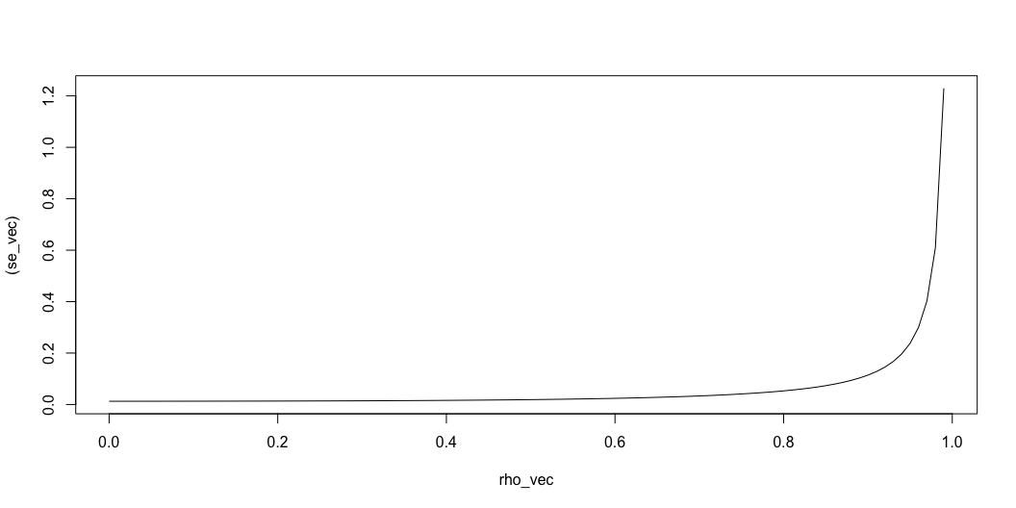
What happens to SE as rho -> 0

Slide 14

Asymptotics
Hessian is hard to calculate.. How?
Under these assumptions we create a confidence interval as MLE +/- 1.96*SE
www.vix.com

Slide 15
Uncertainty for derived quantities
Inverting the Hessian only works for parameters
We often want uncertainty for functions of parameters (‘derived quantities’)
For instance, we may want to know the uncertainty of exp(logA)=A
We know the SE for logA from the inverted Hessian (it is a parameter)
For A we can use the “Delta method”

Slide 16
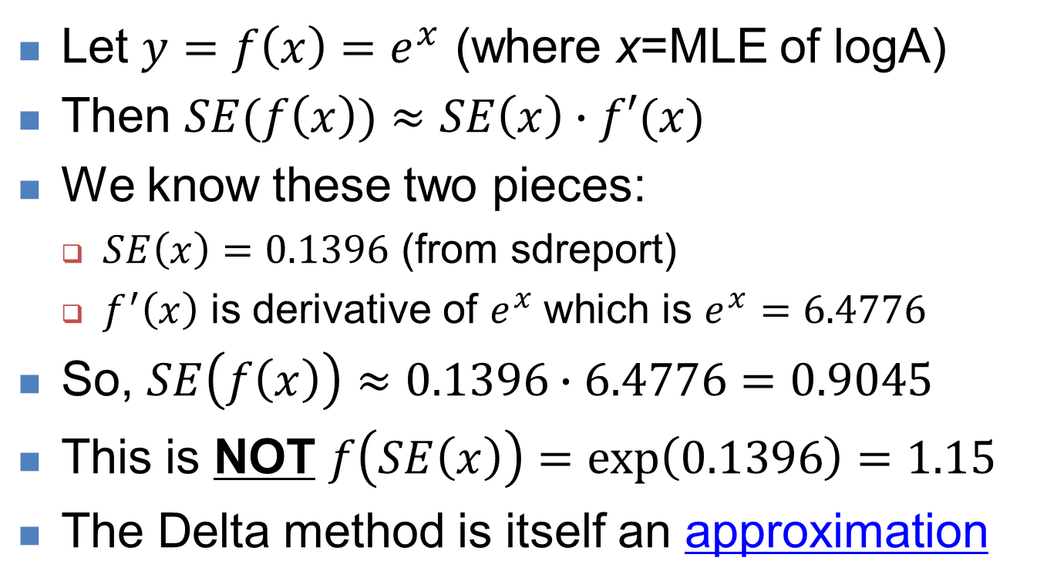
Univariate Delta method
Let $y=f\left(x\right)=e^{x}$ (where x=MLE of logA)
Then $SE(f\left(x\right))≈SE\left(x\right)∙f′(x)$
We know these two pieces:
$SE\left(x\right)=0.1396$ (from sdreport)
$f^{′}\left(x\right)$ is derivative of $e^{x}$which is $e^{x}=6.4776$
So, $SE\left(f\left(x\right)\right)≈0.1396∙6.4776=0.9045$
This is NOT $f\left(SE\left(x\right)\right)=\exp\left(0.1396\right)=1.15$
The Delta method is itself an approximation

Slide 17
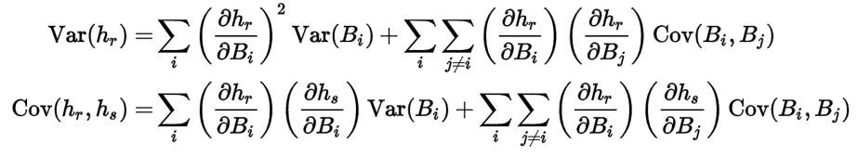
Multivariate Delta method
What about a combination of parameters, like a predicted logR which is a combination of both parameters?
It get’s ugly! From Wikipedia:
That’s a lot of derivatives to do… a better way?

Slide 18
Multivariate Delta method
What about a combination of parameters, like a predicted logR which is a combination of both parameters?
It get’s ugly! From Wikipedia:
That’s a lot of derivatives to do… a better way?
Let TMB do the calculations for you!
www.vix.com

Slide 19
Likelihood profiles
Does not make the asymptotic normal assumption
Essentially: Refit model at series of points, doing likelihood ratio tests at each one
Theory not covered here, but a good approach.
Easy to do in R
This interval may not be symmetic nor finite

Slide 20
Likelihood profiles
A likelihood profile is:
Fit the model to find the ML parameter estimates and find the corresponding negative log-likelihood.
Select a set of fixed values for the quantity of interest.
Minimize the negative log-likelihood fixing the quantity to each value in turn.
Plot the difference between the negative log-likelihood from step 1 and those from step 3

Slide 21
Likelihood profile-III
We can compute confidence intervals from likelihood profiles
Approximate 95% CI

Slide 22
Uncertainty with simulation
Simulate parameter draws from the variance-covariance matrix
Can be easier to implement than delta method
Do a example later today

Slide 23
Uncertainty with bootstrapping
A non-parametric approach that makes no distributional assumptions
Instead, resample data with replacement, refit model, save estimates
Repeat many times (say 1000) and look at distribution of estimates
A whole literature on this approach, see e.g.:
Efron, Bradley, and Robert J. Tibshirani. An introduction to the bootstrap. CRC press, 1994.

Slide 24
Bootstrapping in R
A quick demonstration on our Ricker model
Nboot <- 1000
boot.results <- matrix(NA, nrow=Nboot, ncol=2)
N <- length(data$SSB)
for(i in 1:Nboot){
ind <- sample(1:N, size=N, replace=TRUE) # resample
data2 <- list(SSB=data$SSB[ind], logR=data$logR[ind])
obj <- MakeADFun(data2,parameters,DLL="bevholt2")
obj$env$beSilent() # silences console output
opt.temp <- with(obj, nlminb(par, fn, gr))
boot.results[i,] <- opt.temp$par
}

Slide 25
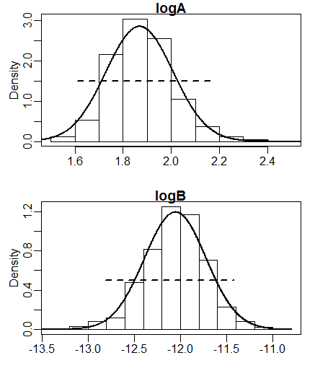
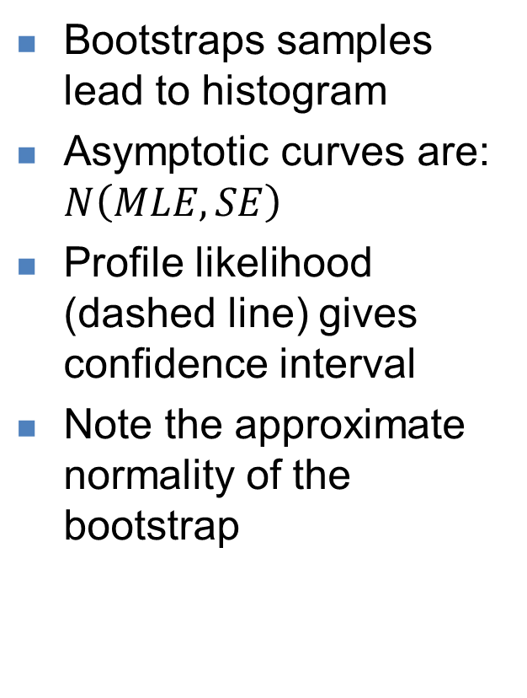
Comparing methods
Bootstraps samples lead to histogram
Asymptotic curves are: $N\left(MLE,SE\right)$
Profile likelihood (dashed line) gives confidence interval
Note the approximate normality of the bootstrap

Slide 26
Recap
Estimating uncertainty is fundamental to a statistical analysis
However these symmetric estimates can fail, and if suspected check it with likelihood profile or bootstrapping
Parameter transformations can sometimes be used to make estimators more symmetric.

